Slide 1
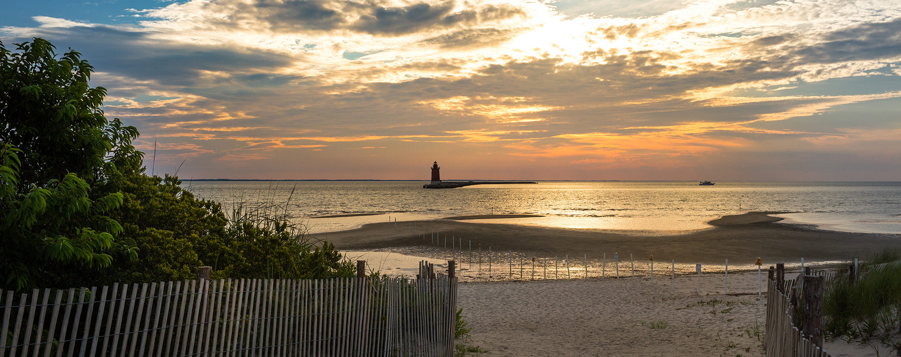
MARACOOS Overview
Congressional Briefing:
MARACOOS High Frequency Radar
Mary Ford, Director of Engagement & External Relations
Dr. Gerhard Kuska, Executive Director
Dr. Hugh Roarty, HFR Regional Coordinator
Notes:
Intro

Slide 2

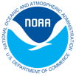



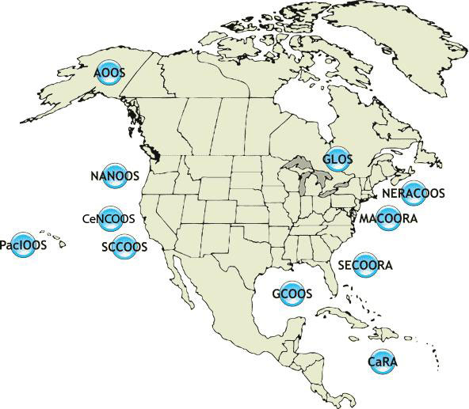


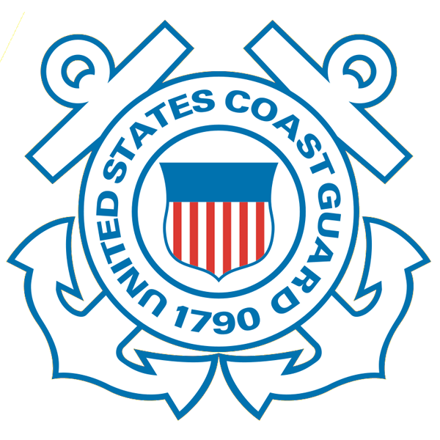
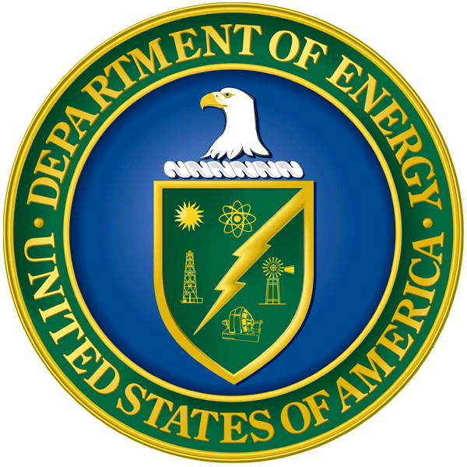






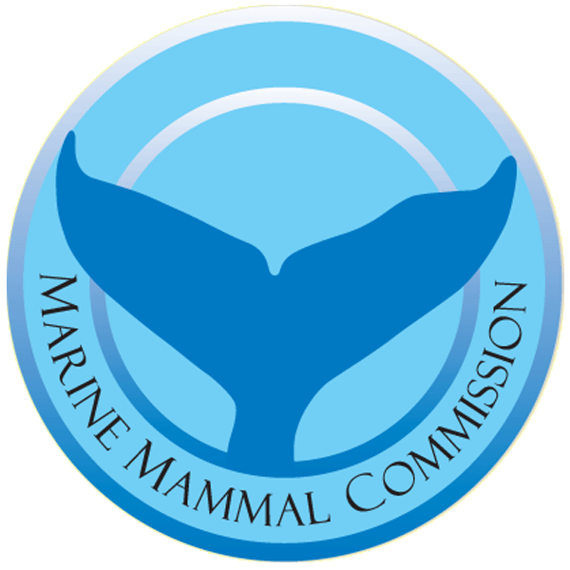

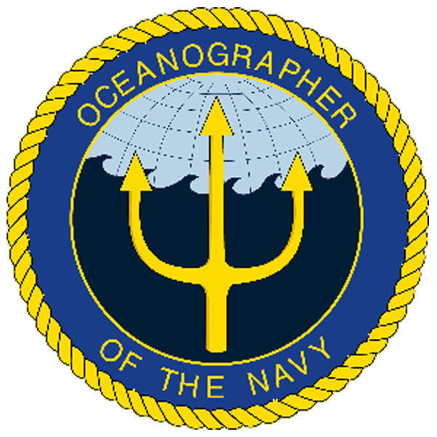
IOOS is a Public-Private Partnership
International Component
U.S. National Component
U.S. Regional Component
Vessels -
Satellite
Satellite
CODAR
Ships/ Vessels
Glider
REMUS
Data Vis.
Modeling
Security
Leadership
Education
MARACOOS
17 U.S. Federal Agencies
11 Regional Associations

Slide 3
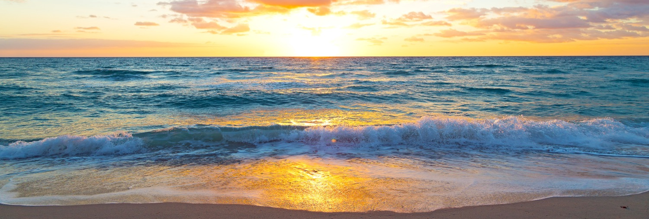
Authorizations & Appropriations from Congress
The Integrated Coastal Ocean Observing System Reauthorization
  H.R. 729, the Coastal and Great Lakes Communities Enhancement Act - Rep. Kilmer (D-WA)
    Passed the House
  S. 914, the Coordinated Ocean Observations and Research Act – Sen. Wicker (R-MS)
    Final negotiations
FY20 Appropriations
  $40.5 million for IOOS Regional Observations
  “The Committee supports IOOS’ efforts to expand its use of underwater gliders and encourages NOAA to fill critical gaps in the current surface mapping system to ensure streamlined access to data for weather forecasting, detection of ecological phenomena, and safe maritime operations.”
Notes:
The program is up for reauthorization right now, has passed both Senate and House at different times. Last Congress, it passed the Senate and not the House. This Congress, the House version already passed in a larger package and the Senate version has been reported out of committee but not yet passed (almost there…!).
THANK THEM for funding in the last appropriations bills note we will discuss gliders at our next webinar.
Use bolded report language to segue into HF Radar section, introduce Hugh
2 minutes maximum

Slide 4
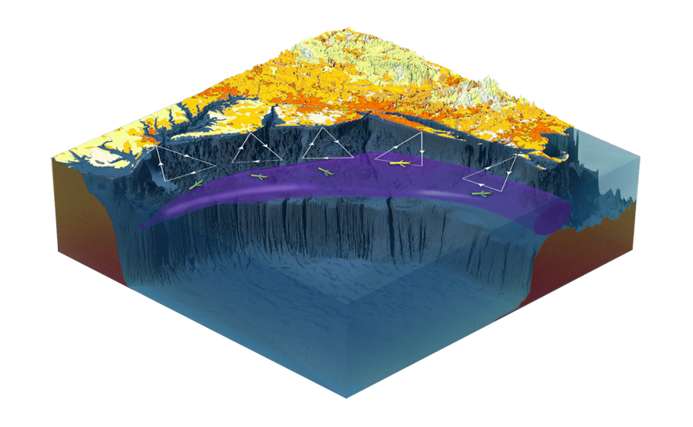
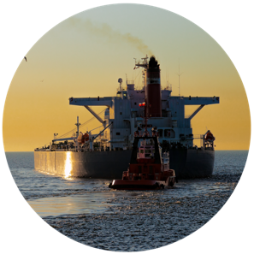
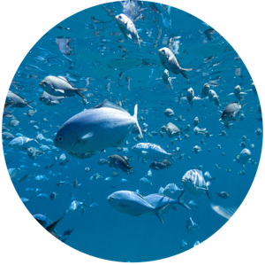
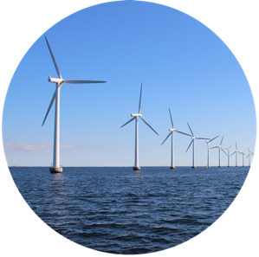
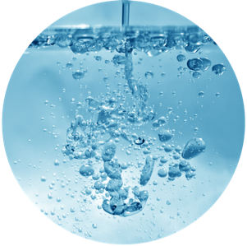
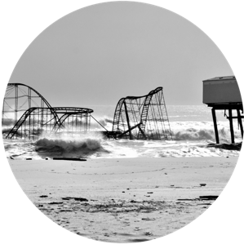
Data with Purpose
Maritime Safety
Fisheries
Energy
Water Quality
Coastal Hazards

Slide 5
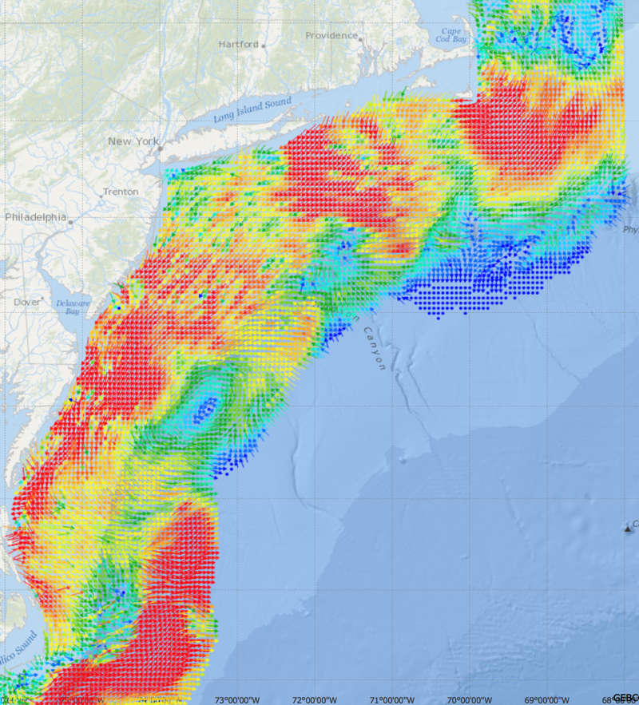
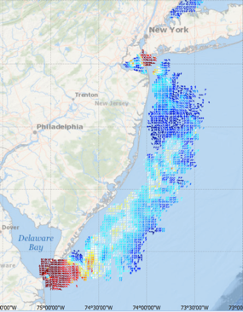
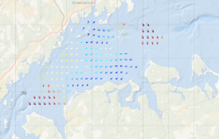
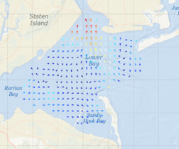
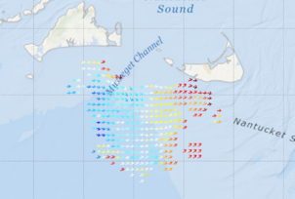
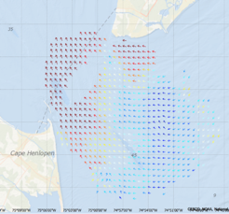

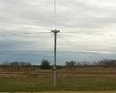
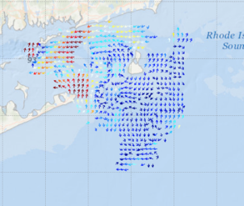
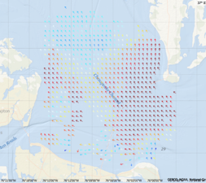
High Frequency Radar Network – HF-Radar
Long Range Network
Western Long Island Sound
5 MHz - 17 Stations
13 MHz - 8 Stations
25 MHz - 16 Stations
TOTAL – 41 Stations
New Jersey 13 MHz
New York Harbor
Winter Storm Jonas
2016/01/23 20:00 UTC
Muskeget Channel
Delaware Bay
Block Island Sound
Key Applications
Search and Rescue
Coastal Hazards
Maritime Safety
Water Quality Forecasting
Chesapeake Bay
Notes:
Sends a radar signal out across the water
About as much energy as a 100w light bulb
3 types of networks with 3 resolutions
The mid range also measure wave height just offshore.

Slide 6
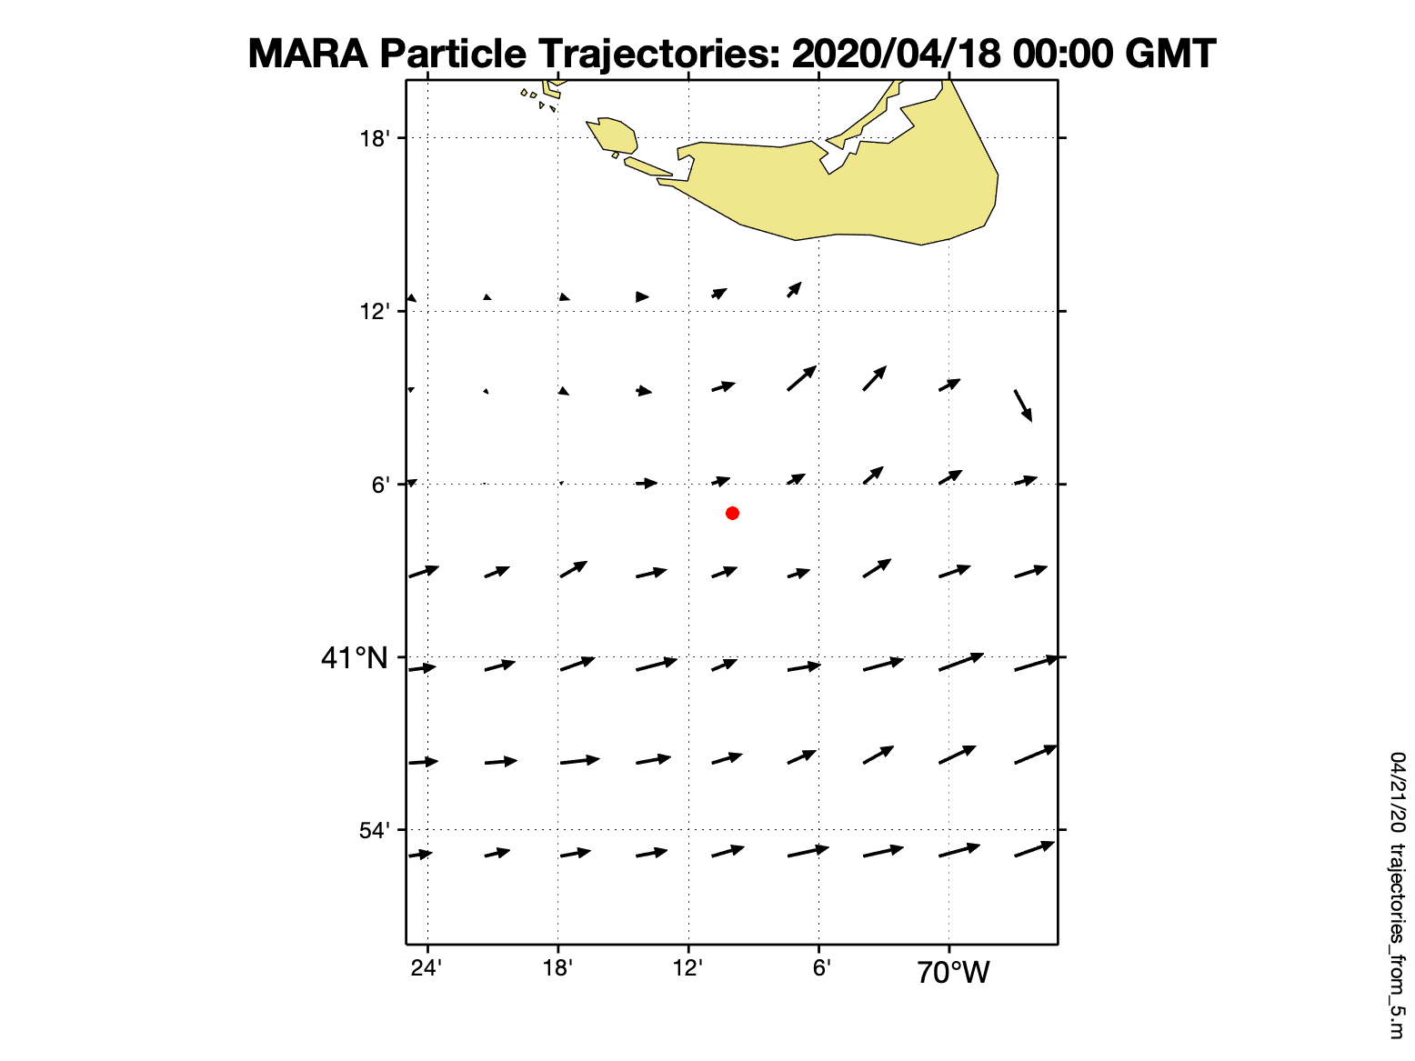
Surface Currents from HF Radar
5 miles

Slide 7
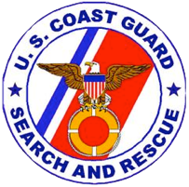
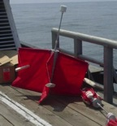
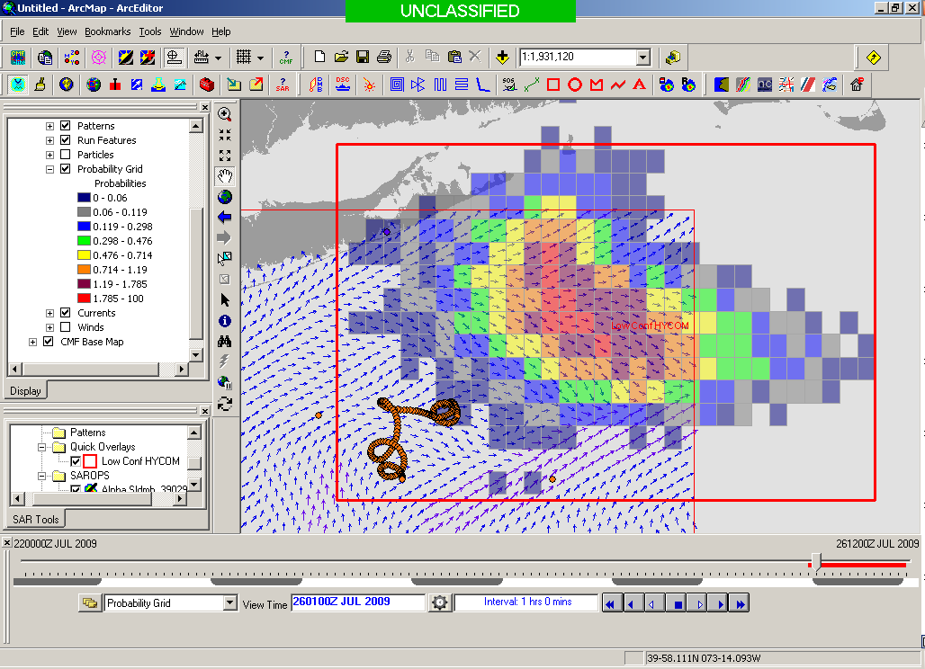
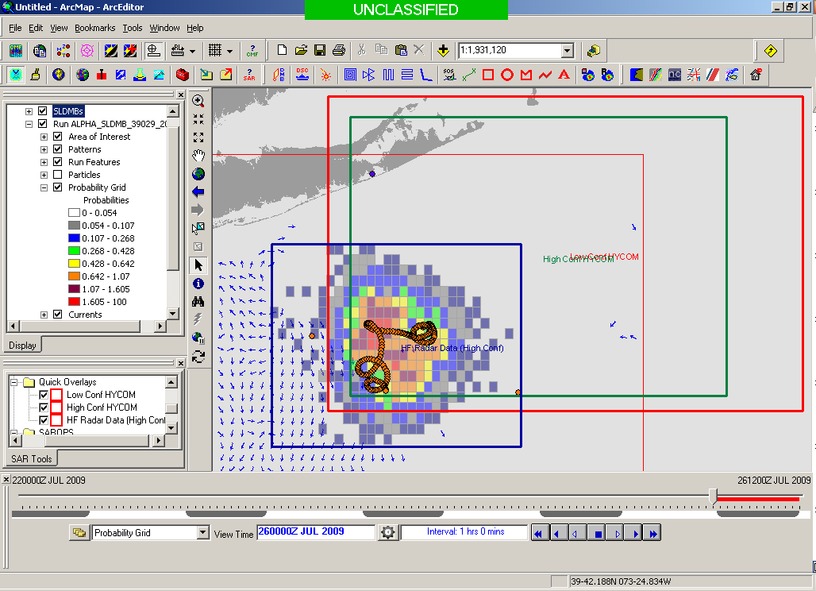
Application: USCG Search and Rescue
Results of a 1-year blind validation study -
For every real drifter deployed at sea:
5000 Virtual Drifters Deployed in SAROPS
Search Areas compared to real drifters every 12 hours
154 km
100 km
232 km
123 km
HYCOM 96 hour Search Area
36,000 km²
HF Radar 96 hour Search Area
12,000 km²
Notes:
Here are the initial deployment positions for our SLDMBs. From these records we selected only those that exceeded 4 days in length

Slide 8
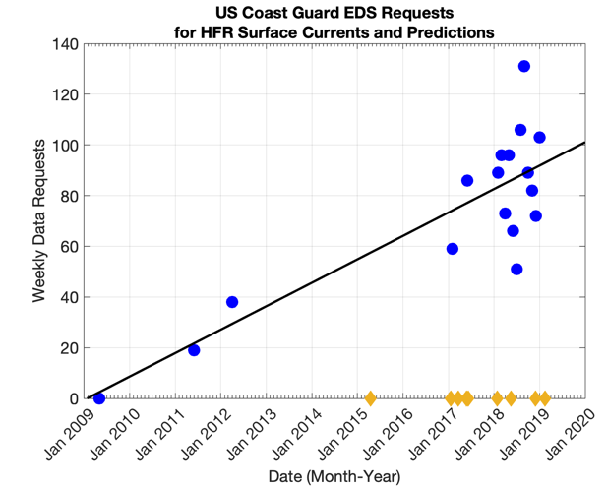
National Use of HFR Data and Predictions
MARACOOS surface currents operational with USCG May 4, 2009
US IOOS surface currents operational with USCG March 2011
MARACOOS engagement events with USCG

Slide 9
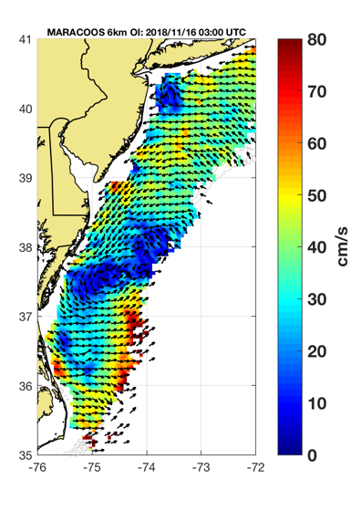
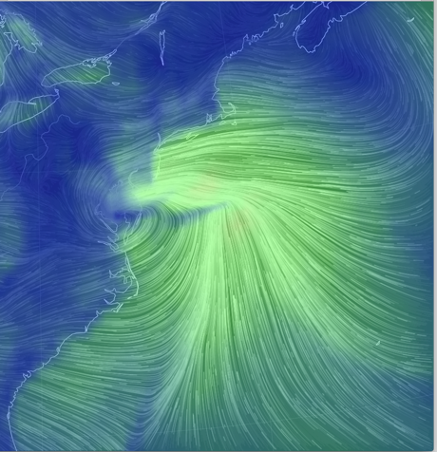
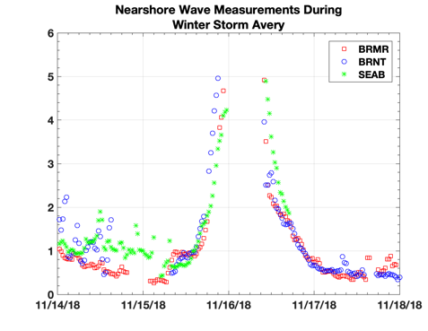
HFR Highlights: Winter Storm Avery – 11-15-18
GFS 11/16/2018 03:00 UTC
HFR 11/16/2018 03:00 UTC
L
L
Notes:
Example of data during a noreeaster.
Surface currents match up with center of the low.
Data can be used to better pinpoint location of a low offshore - NWS

Slide 10
Impacts of COVID-19 Pandemic on Radar Network
Aging infrastructure is leading to increased failures
The manufacturer of the radar is working at a reduced level leading to longer turnaround times
All preventative maintenance has been put on hold
This will lead to gaps in coverage and less accurate measurements
All of this results in a lower quality product to the Coast Guard for Search and Rescue, resulting in larger search areas and increased use of resources

Slide 11
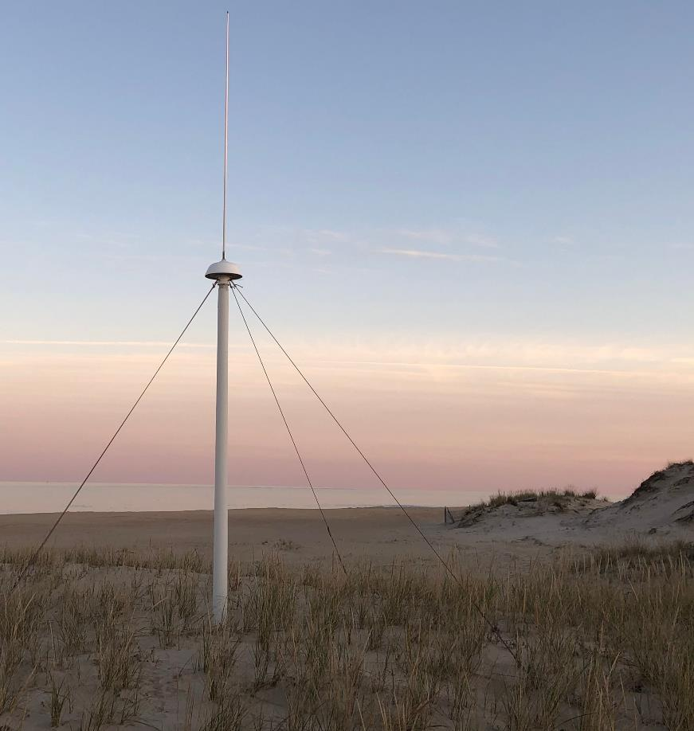
MARACOOS High Frequency Radar
Questions?
info@maracoos.org
www.maracoos.org
302-605-2727

